Slide 1

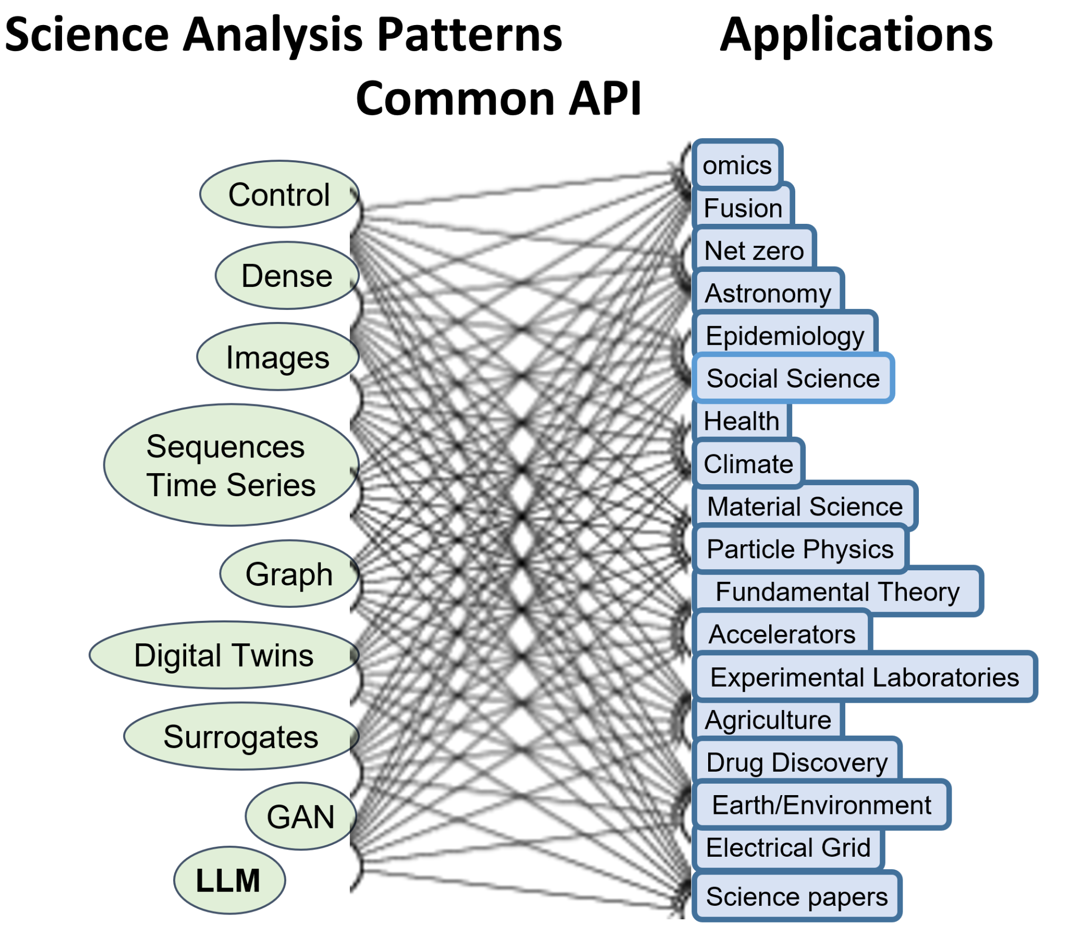
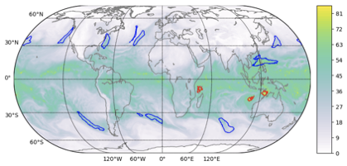
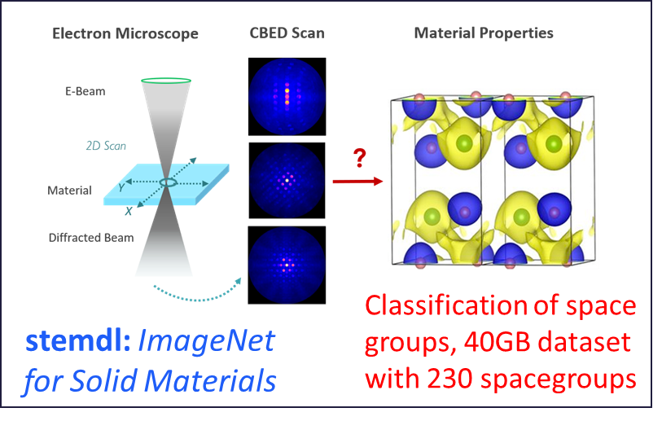
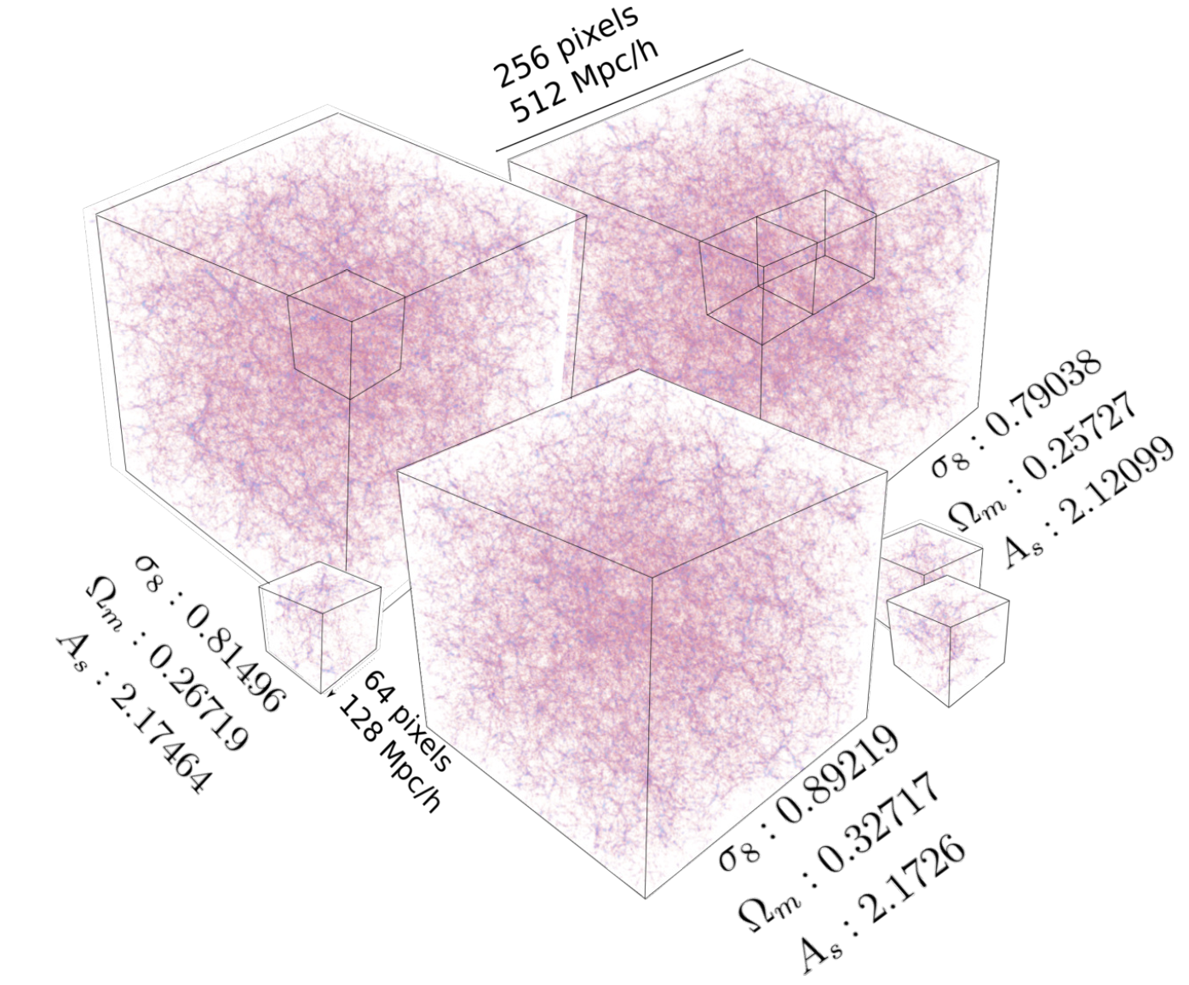
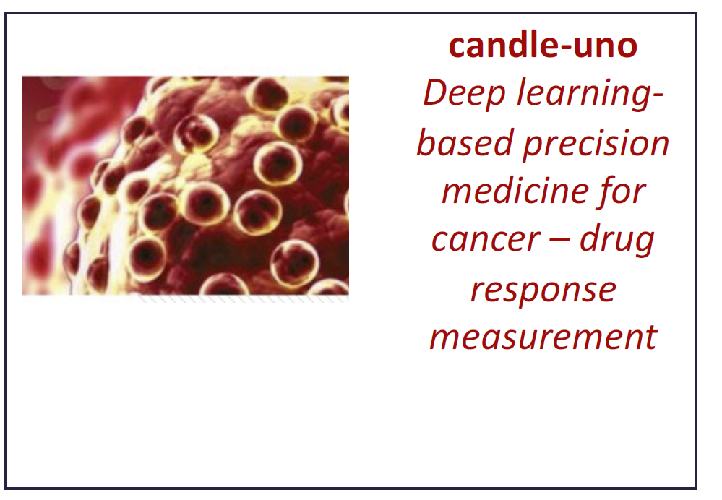
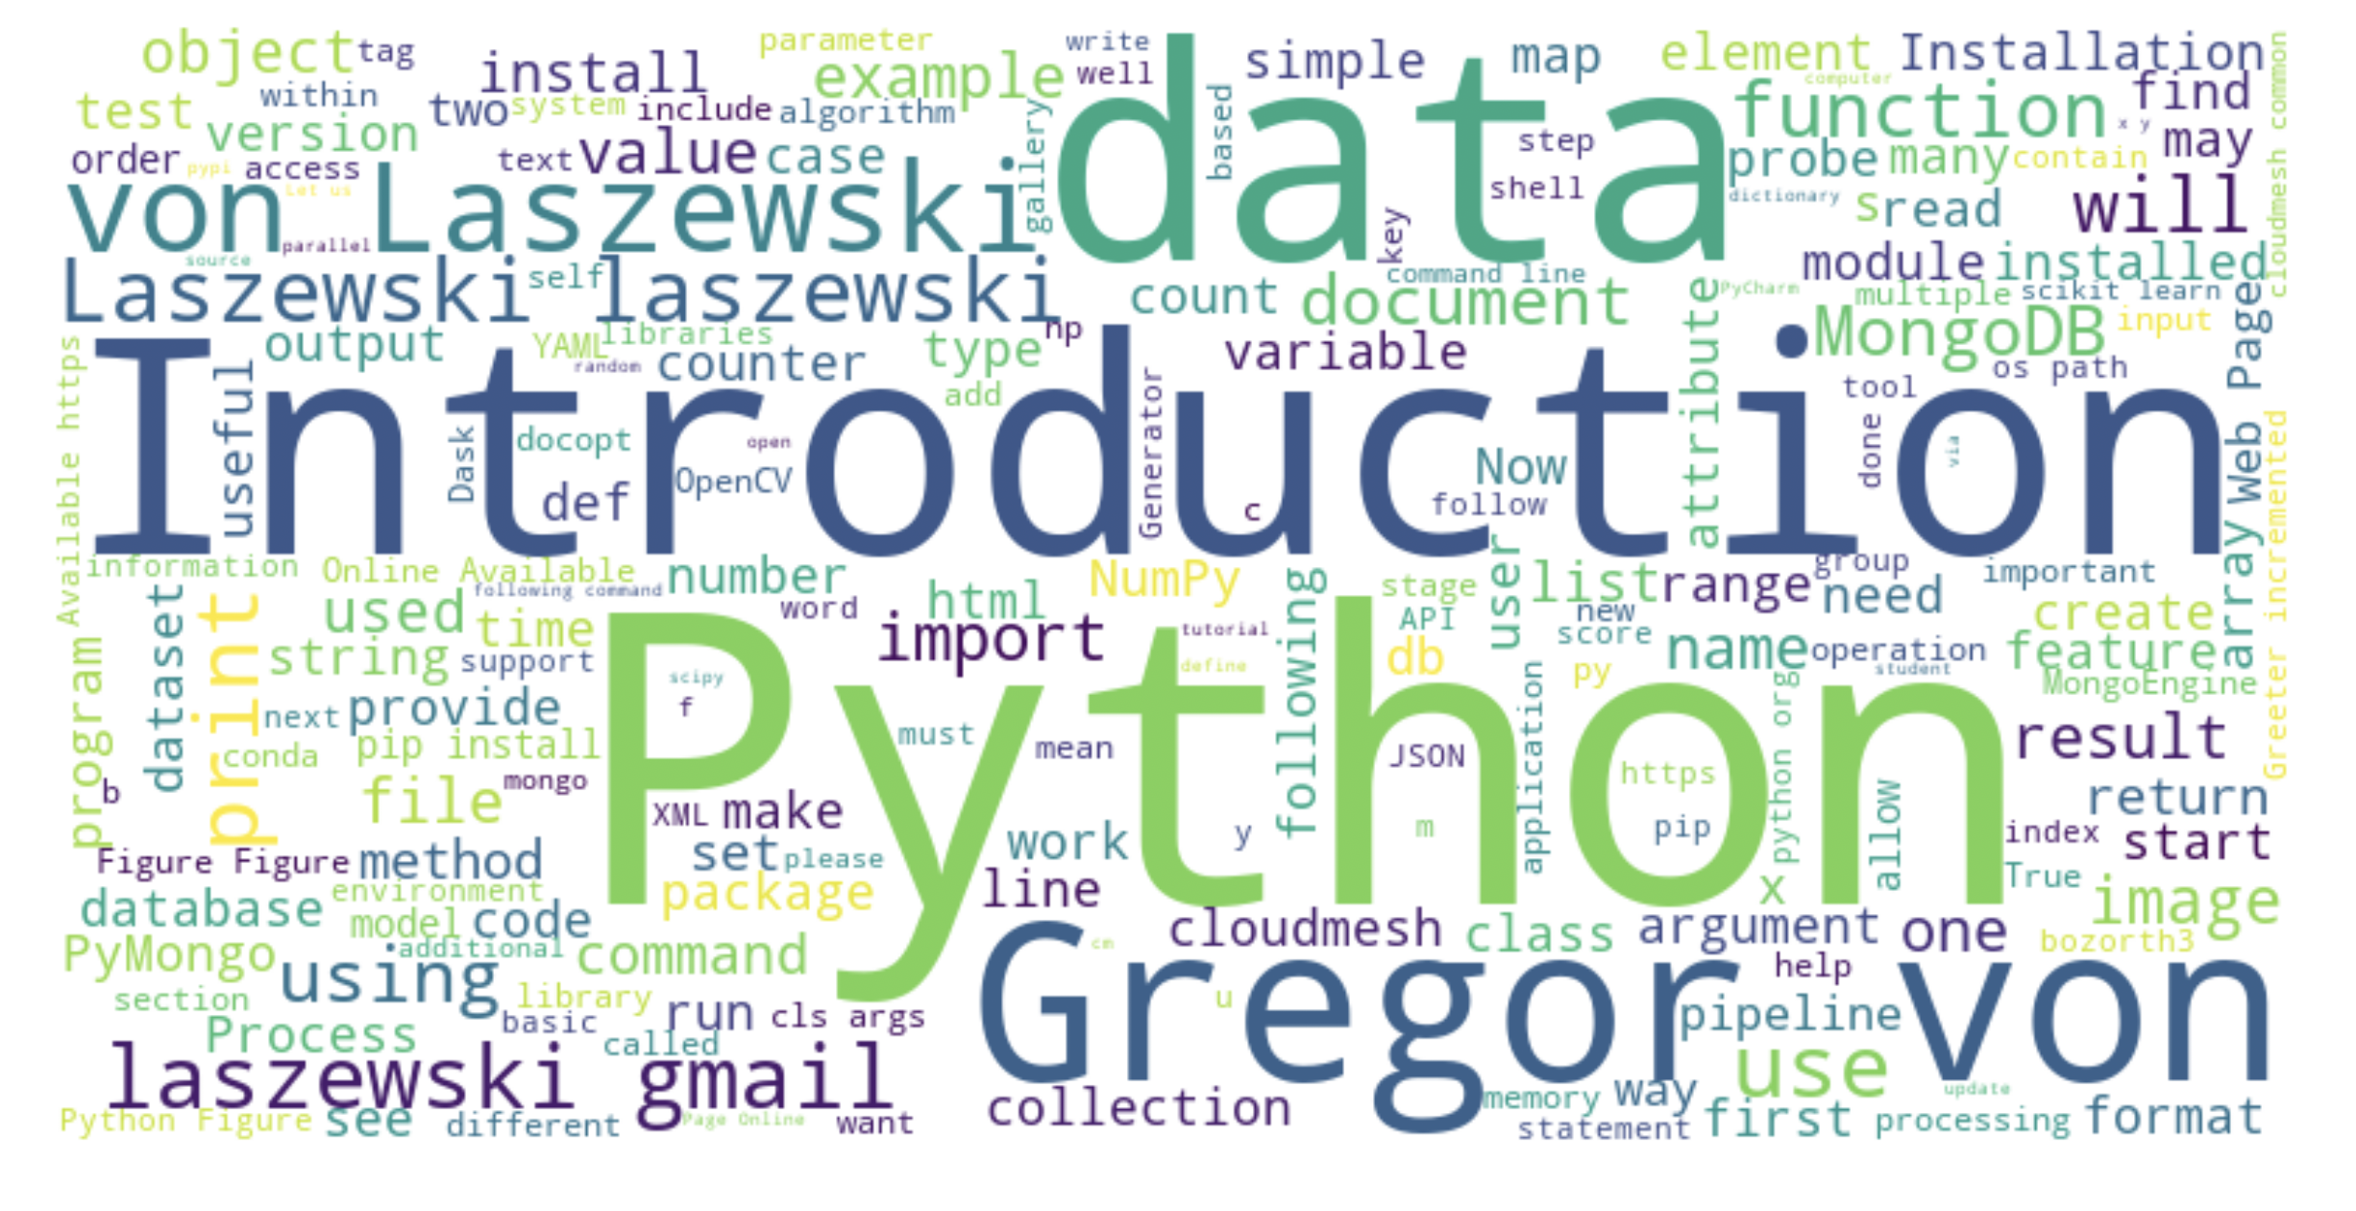
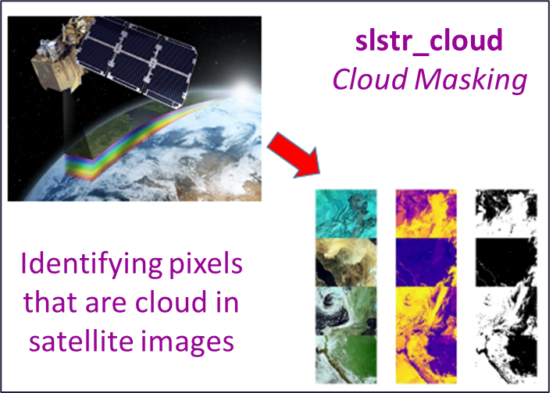
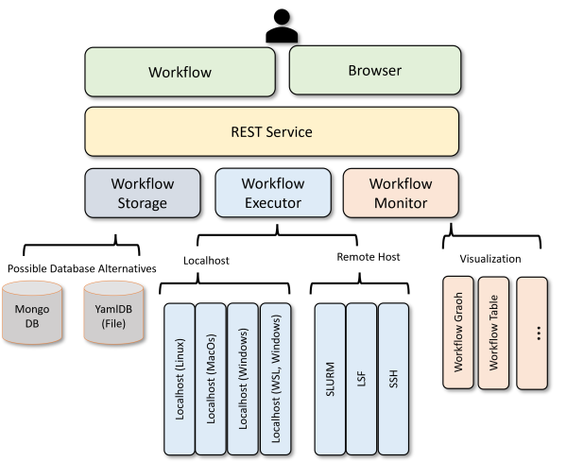
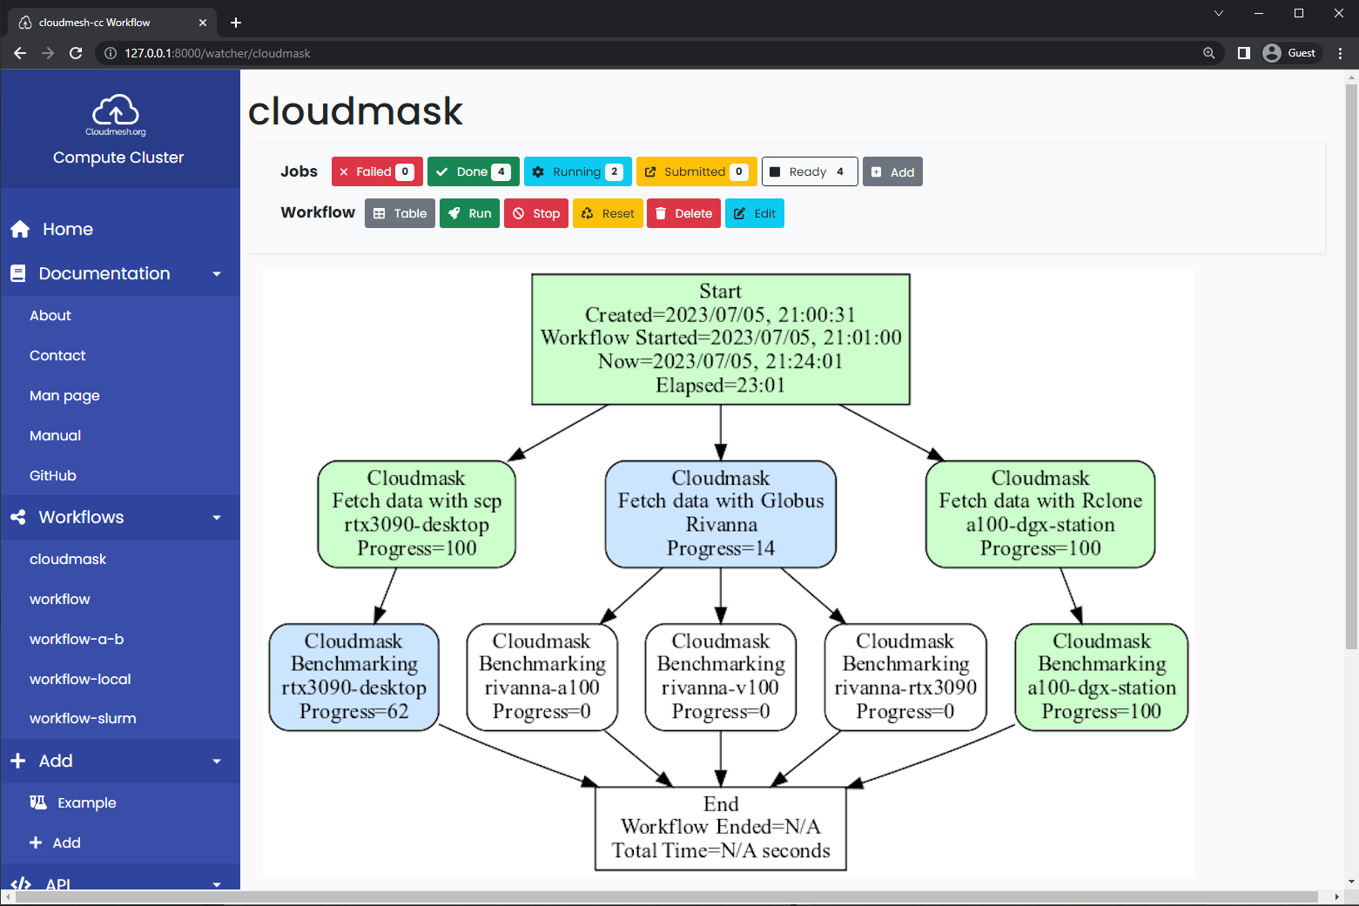
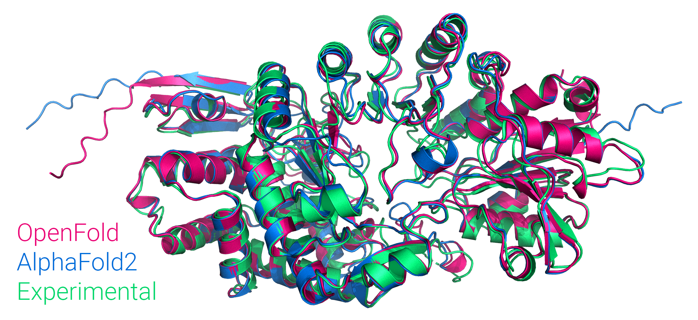
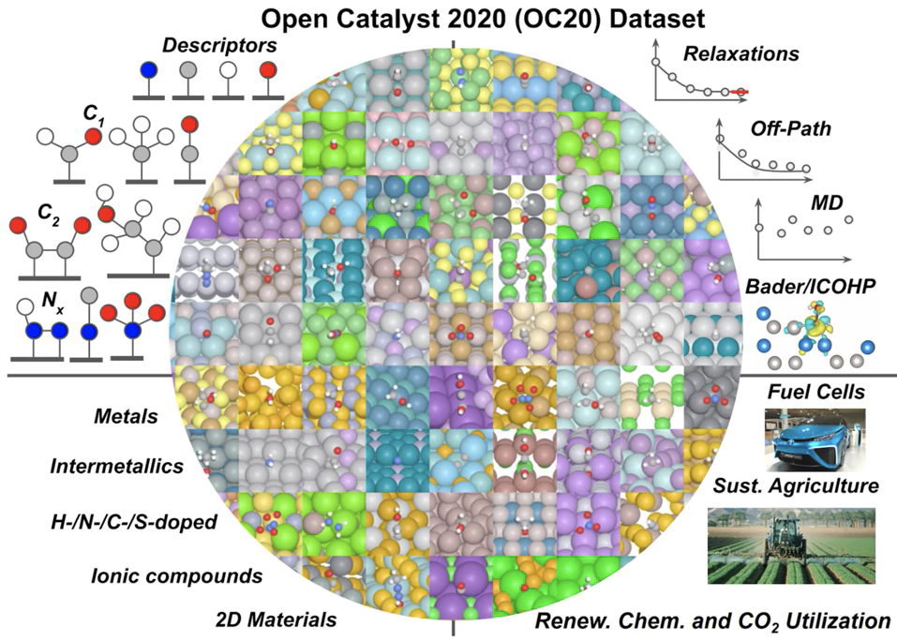
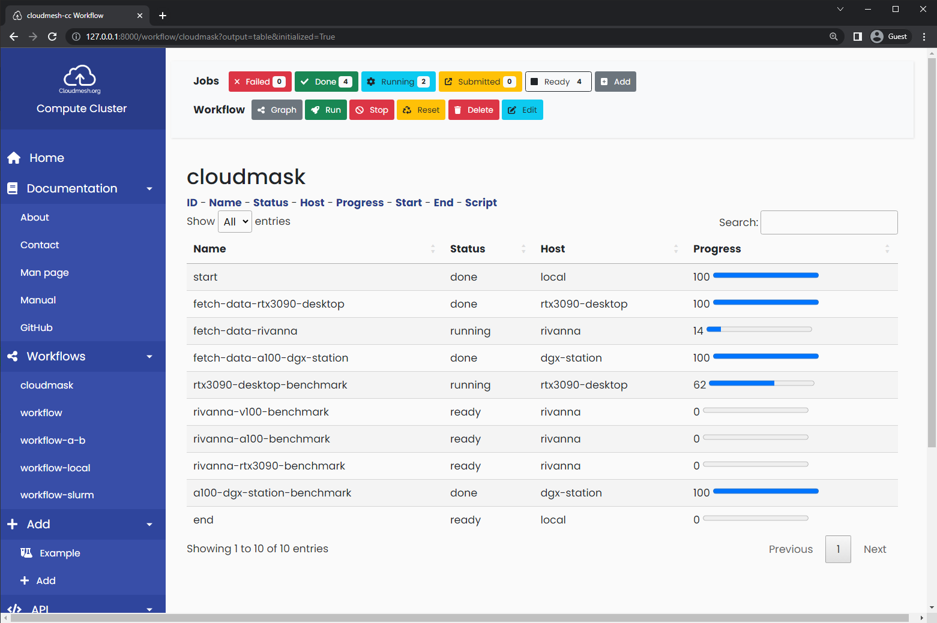
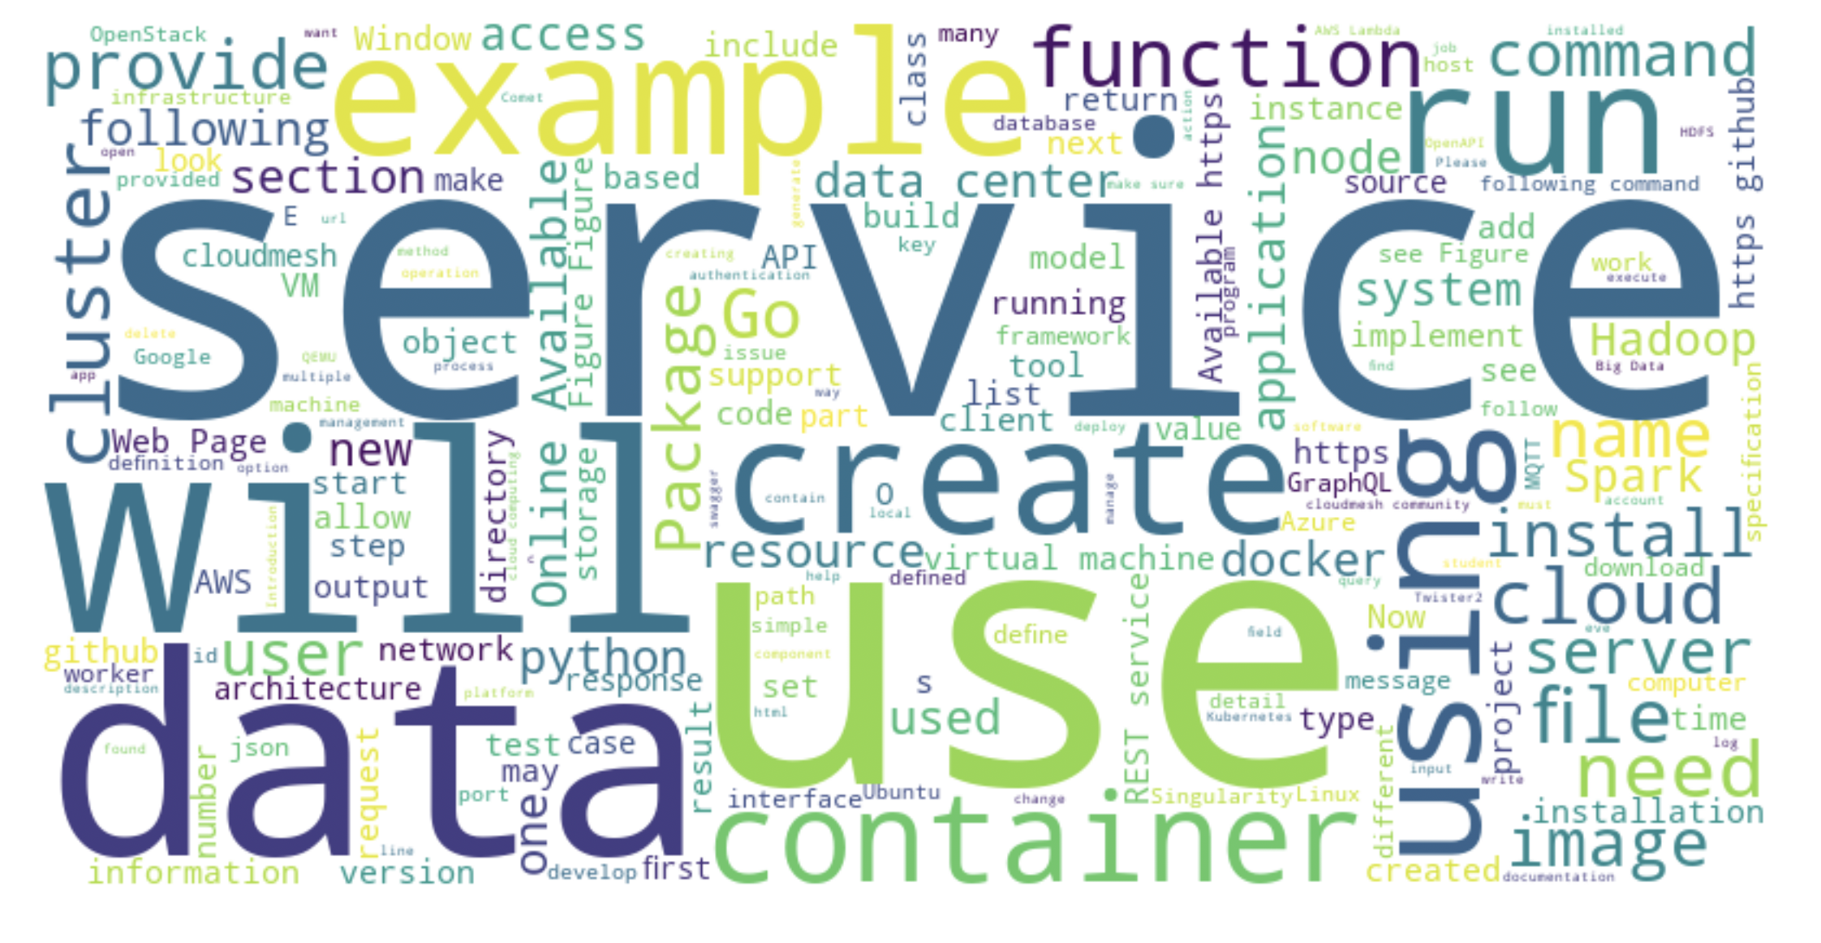
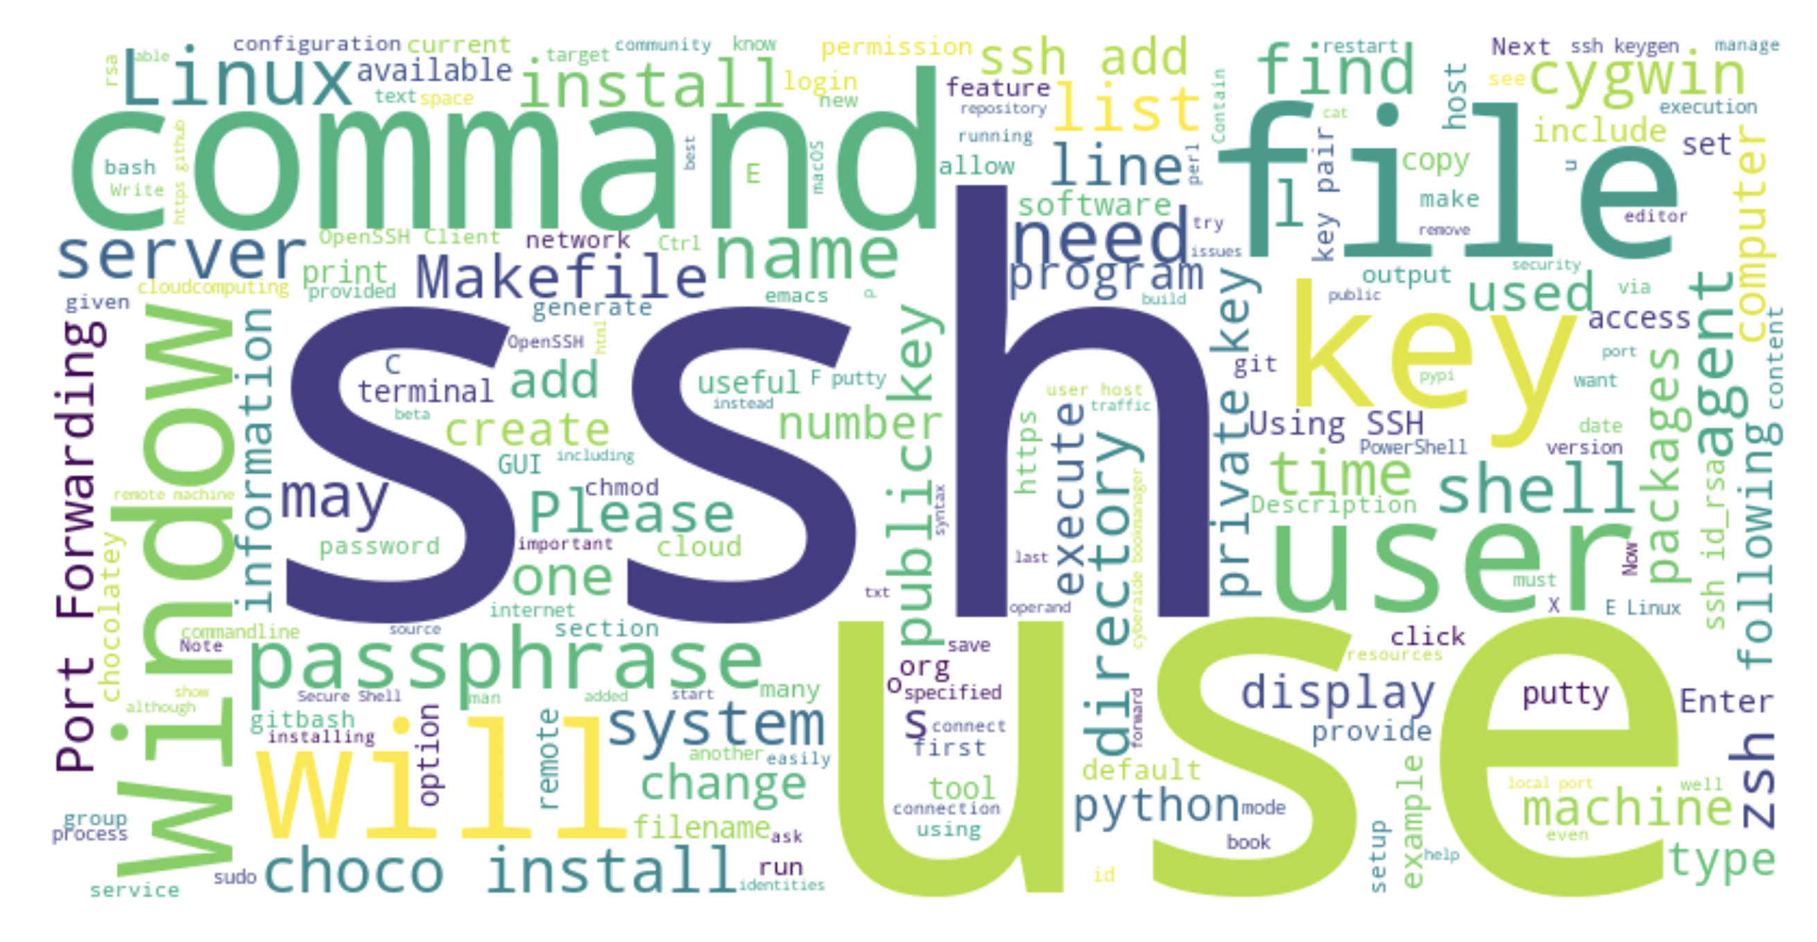
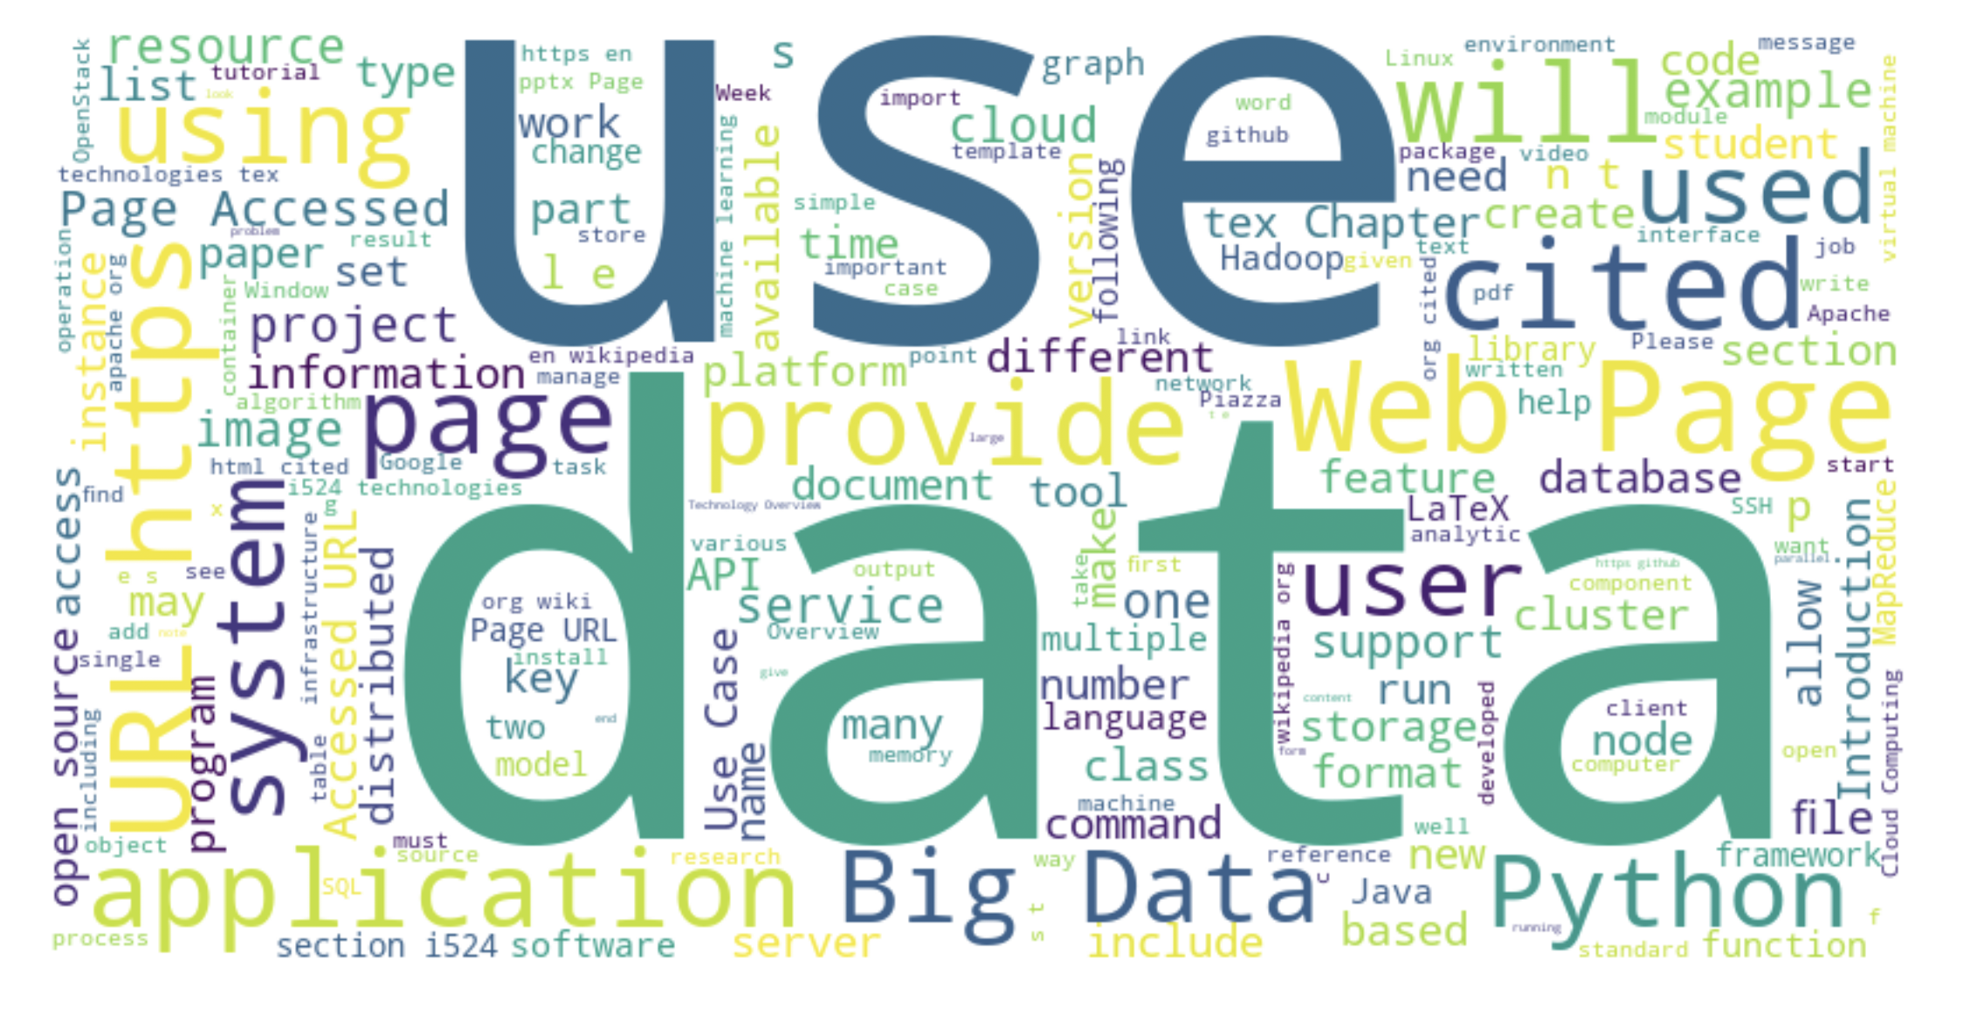
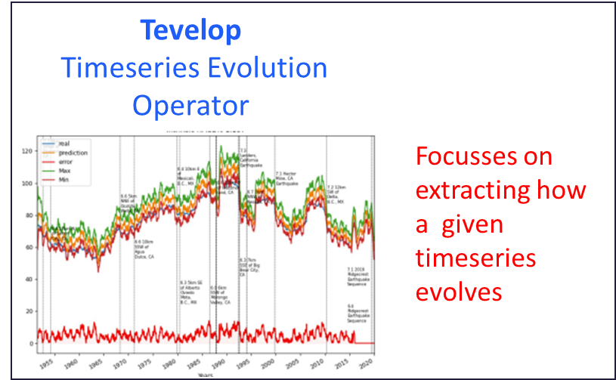
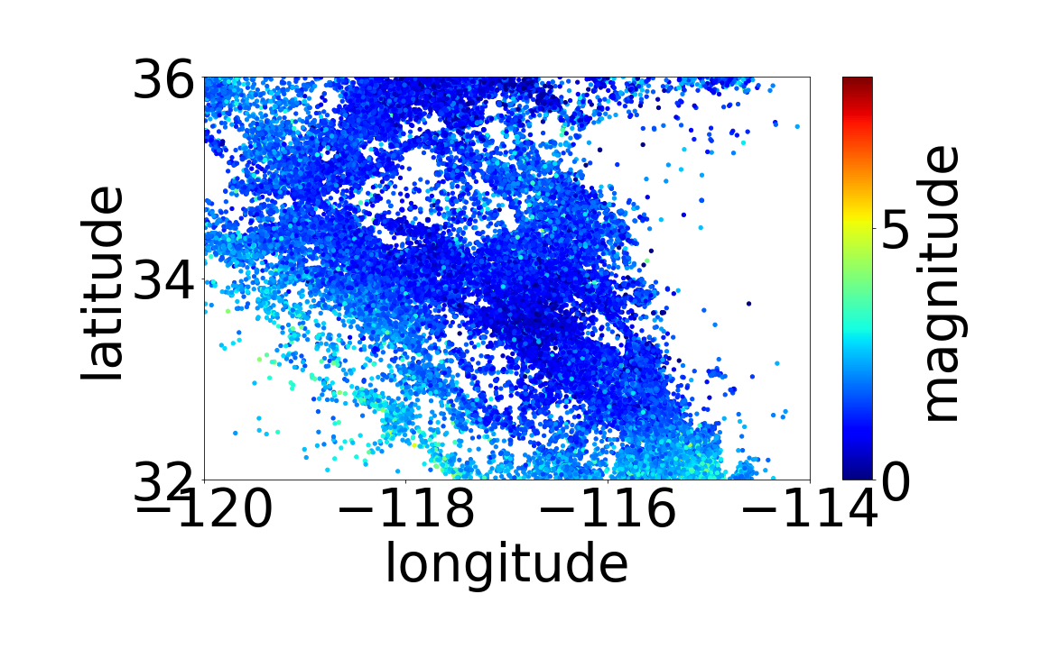


References
Opportunities for Enhancing MLCommons Efforts while leveraging Insights in High-Performance Big Data Systems Gained from Educational MLCommons Earthquake Benchmarks Efforts, G. von Laszewski, J.P. Fleischer, Robert Knuuti, Geoffrey. C. Fox, et.al. Frontiers, 2023, Sep. accepted
Artificial Intelligence for Science A Deep Learning Revolution, 2023 A. Choudhary, G. C Fox, T. Hey doi: 10.1142/13123
Cloudmesh Experiment Executor, https://github.com/cloudmesh/cloudmesh-ee
Cloudmesh Compute Coordinator, https://github.com/cloudmesh/cloudmesh-cc
MLCommons Impact on Science Research Education
Problem:
Educational efforts often only showcase limited/small AI/DL applications
Impact of Cyberinfrastructure often not sufficiently covered
Need for customizable educational components
Cyberinfrastructure
Deep Learning
Applications
Solution:
MLCommons goal is accelerate machine learning innovation (over 70 members from industry, academia, and government)
Rich set of applications allowing to gain insights into deep learning
Allows insight into Benchmarking and its issues
Opportunities to obtain holistic view of interplay between applications, cyberinfrastructure, benchmark requirements
Outcome: a well-educated research and professional workforce
Rapid changes in these fields require quick adaptation of material
Different backgrounds of students require customization of material
We developed open-source framework and tools that allow customized material to be given to each student after evaluation.
University, NSF, and DOE machines provide Cyberinfrastructure
We developed cloudmesh compute coordinator and experiment executor to coordinate AI applications on hybrid machines
Many more applications are available from MLCommons
Multi-modal Science Foundation Models
DeepCAM Climate
stemdl
Cosmoflow Universe
Candle-Uno Drug Discovery
MLCommons AI4Science
And HPC Benchmarks
MLCommons Cloudmasking Using Cloudmesh Experiment Execution
Cloudmesh
Compute
Coordinator
GNN Chemistry
Architecture
Openfold Protein Structure
MLCommons Earthquake using Tevelop
Impact of Hyperparameter
controlling inputs and outputs
Earthquake data
GPU Performance
Energy traces
NSF 2200409, 1829704 NIST 60NANB21D151T DOE DE-SC0023452
Geoffrey C. Fox, Gregor von Laszewski
vxj6mb@virginia.edu, gregor@virginia.edu
BIOCOMPLEXITY INSTITUTE

